Slide 1
OXO Model conversion from Julia(IES framework) to Python(DS framework)

Slide 2
OXO model
Objective
Minimize or Maximize KPI
Prediction target: KPI formula
DCS tags as feature data
Training – Julia -> Export .csv files (model weights)
Evaluation (Live) – Python <- Load .csv files (model weights)

Slide 3
New OXO model
DS training (Python) – Historical module
DS live script (Python) – Live module

Slide 4
What IES need to provide to DS
KPI formula & DCS tag list (Uniform for all product types)
Provide precise info for each KPI
Product Labeling data (historical) -> dates info for Four product type
Future discussion for dynamic boundary, limitation, etc Domain analysis to find out the safe operation range for each control (directives) tags. Until then, if possible, let’s use non-domain boundaries (Like historical range. Because current IES framework does not have any domain boundary anyways.)

Slide 5
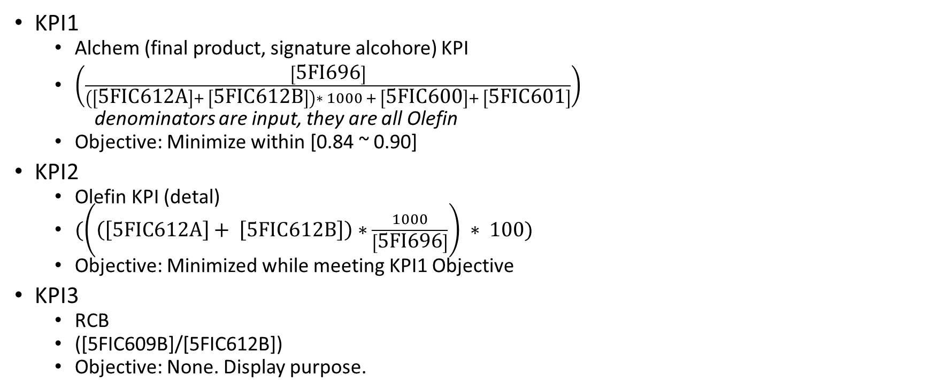
KPI Formula
KPI1
Alchem (final product, signature alcohore) KPI
$\left(\frac{\left[\text{5}\text{FI}\text{696}\right]}{\left(\left[\text{5}\text{FIC}\text{612}\text{A}\right]+ \left[\text{5}\text{FIC}\text{612}\text{B}\right]\right)∗ 1000 + \left[\text{5}\text{FIC}\text{600}\right]+ \left[\text{5}\text{FIC}\text{601}\right]}\right)$
denominators are input, they are all Olefin
Objective: Minimize within [0.84 ~ 0.90]
KPI2
Olefin KPI (detal)
$(\left(\left(\left[\text{5}\text{FIC}\text{612}\text{A}\right]+ \left[\text{5}\text{FIC}\text{612}\text{B}\right]\right)∗\frac{1000}{\left[\text{5}\text{FI}\text{696}\right]}\right) ∗ 100)$
Objective: Minimized while meeting KPI1 Objective
KPI3
RCB
([5FIC609B]/[5FIC612B])
Objective: None. Display purpose.

Slide 6
Improvement
IES framework (Julia script) currently cannot implement the constraints requested by client.
DS framework (Python script) will be able to use entire DCS tags requested by the client along with its constraints requested (“Target” column on SASOL_OXO_2023_Full_Tag_List.xlsx).

Slide 7
Challenge: Four Products (Only difference with other processes)
We can make model without this concern and implement this later. (Use LIAL123 as a base model, because 90% of time it’s LIAL123)
Four product types: LIAL111, LIAL123, LIAL145 and LIAL119
Data input: Manual excel sheet of Product planning (Need to confirm with someone who might know well about this. Currently seems broken.)
IES framework: Different set of feature tags (DCS tags) for each product type
DS framework: Let’s use uniform tag list, there was no clear reason for using different set of tag list.

Slide 8
Challenge: Data Availability
5FIC695 is not available on Maestro.
Dylan checked the tag and said SASOL needs to add this tag
Please check with the client

